Slide 1
Welcome to presentation on Horizontal scanning and vertical scanning

Slide 2
Presented To:
Md. Imran Hossain
Assistant Professor
Department of ICT
Comilla University

Slide 3
Presented by:
Tanvir Mohammad Sakil
ID:11809027
Department of ICT
Comilla University

Slide 4
Vertical Scanning signal
The vertical scanning signal for conventional black and white NTSC is quite straightforward. It is simply a positive ramp until it is time for the beam to return to the upper left- hand corner. Then it is a negative ramp during the blanked
scan lines.
docsity.com

Slide 5
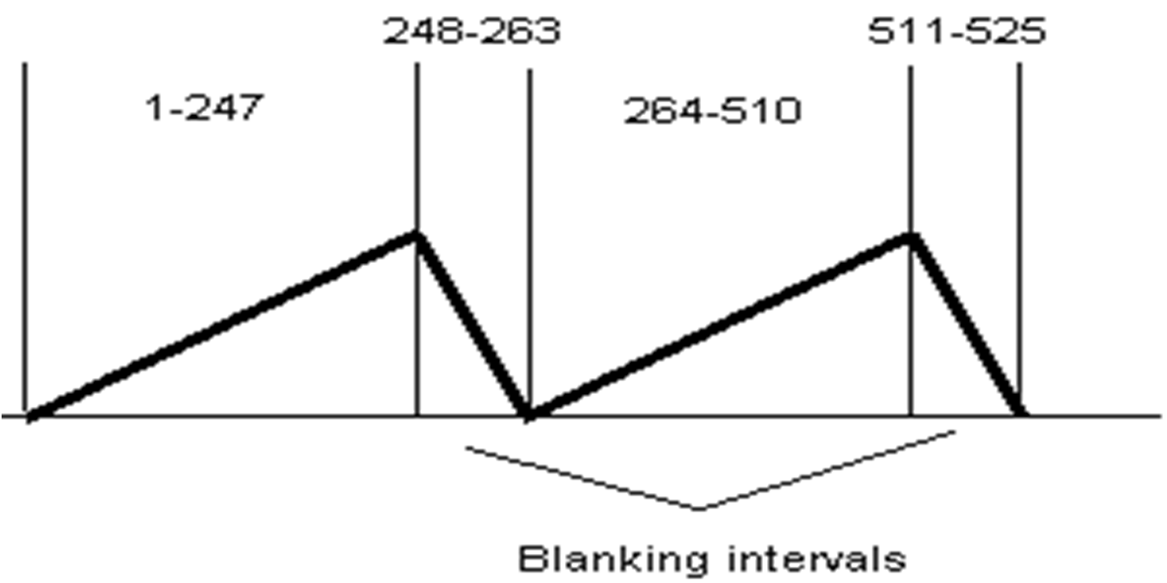
docsity.com

Slide 6
Horizontal Scanning signal
The horizontal scan signal is very much the same. The horizontal scan rate is 525*29.97 or 15,734 Hz. Therefore,
63.6 uS are allocated per line. Typically about 10 uS of this is devoted to the blanking line on the horizontal scan. There are 427 pixels per horizontal scan line and so each pixel is scanned for approximately 125 ns.

Slide 7
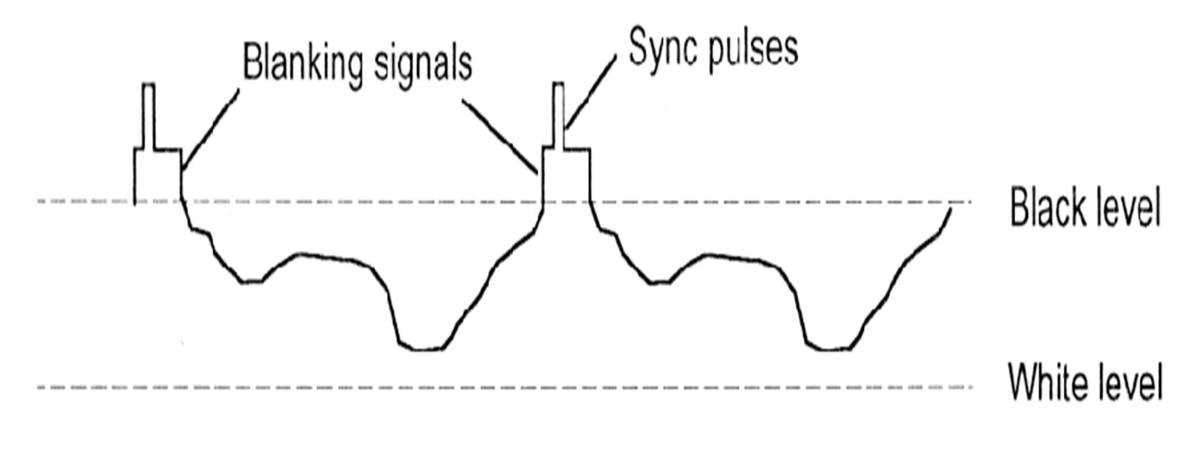
The electron beam is analog modulated across the horizontal line. The modulation then translates into intensity changes in electron beam and thus gray scale levels on the picture screen
docsity.com

Slide 8
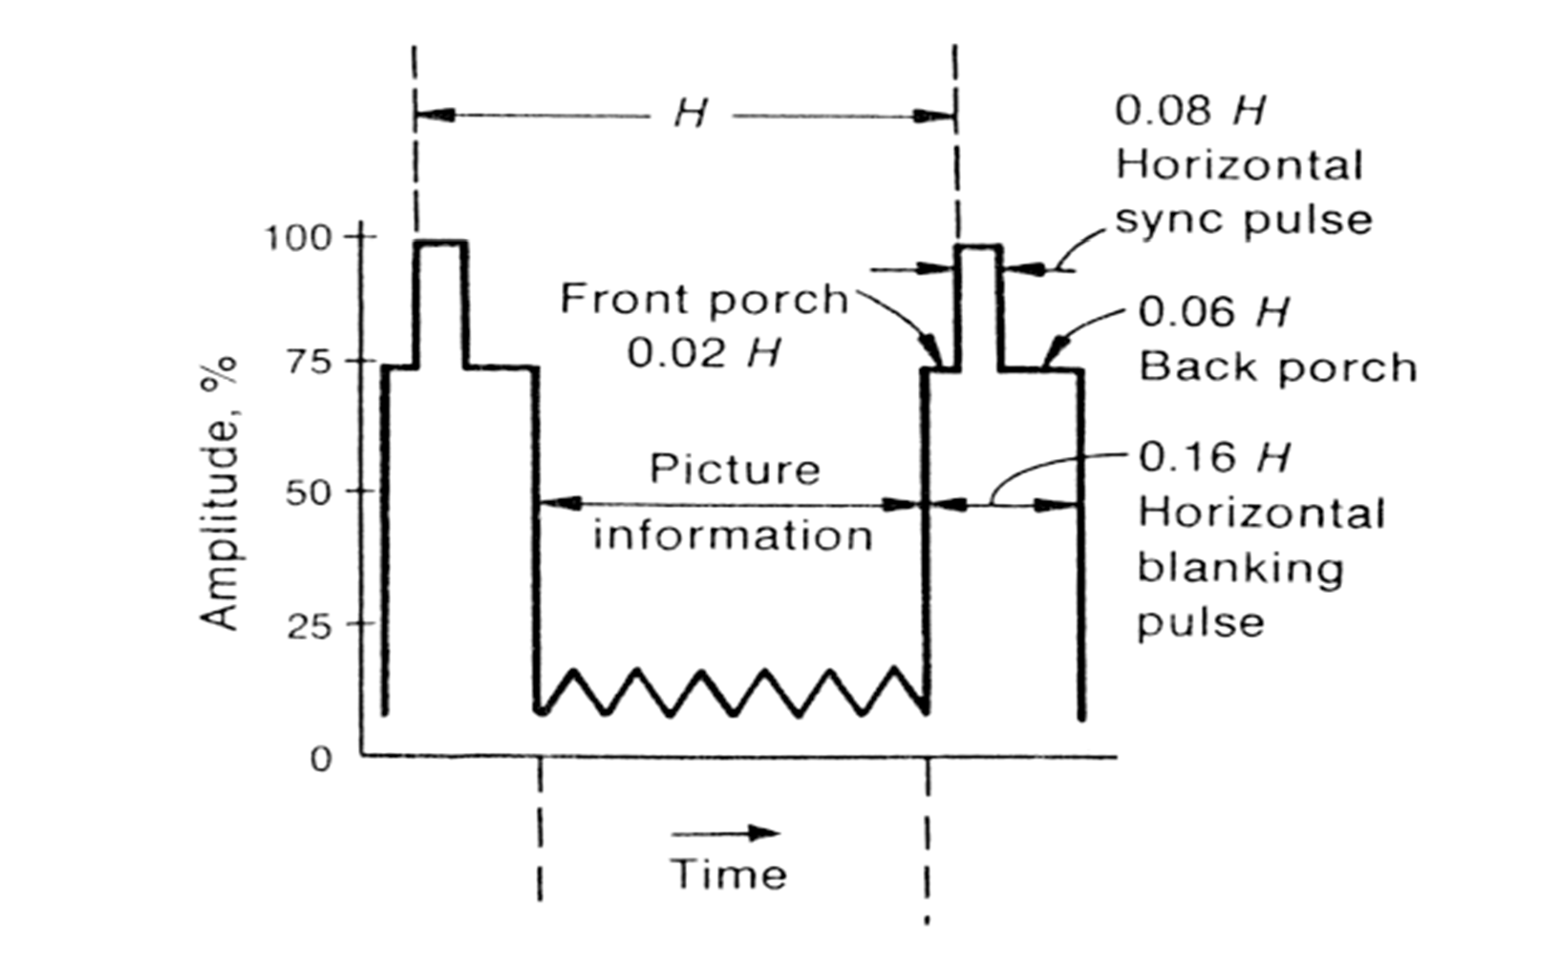
Horizontal blanking signal and synchronization pulse is quite well defined. For black and white TV, the "front porch" is 0.02 times the distance between pulses, and the "back porch" is 0.06 times the distance between pulses.
docsity.com

Slide 9
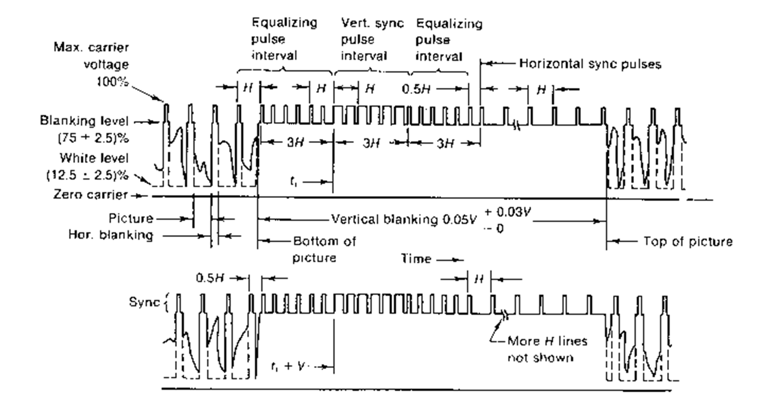
The vertical blanking signal also has a number of synchronization pulses included in it. These are illustrated below.
docsity.com

Slide 10
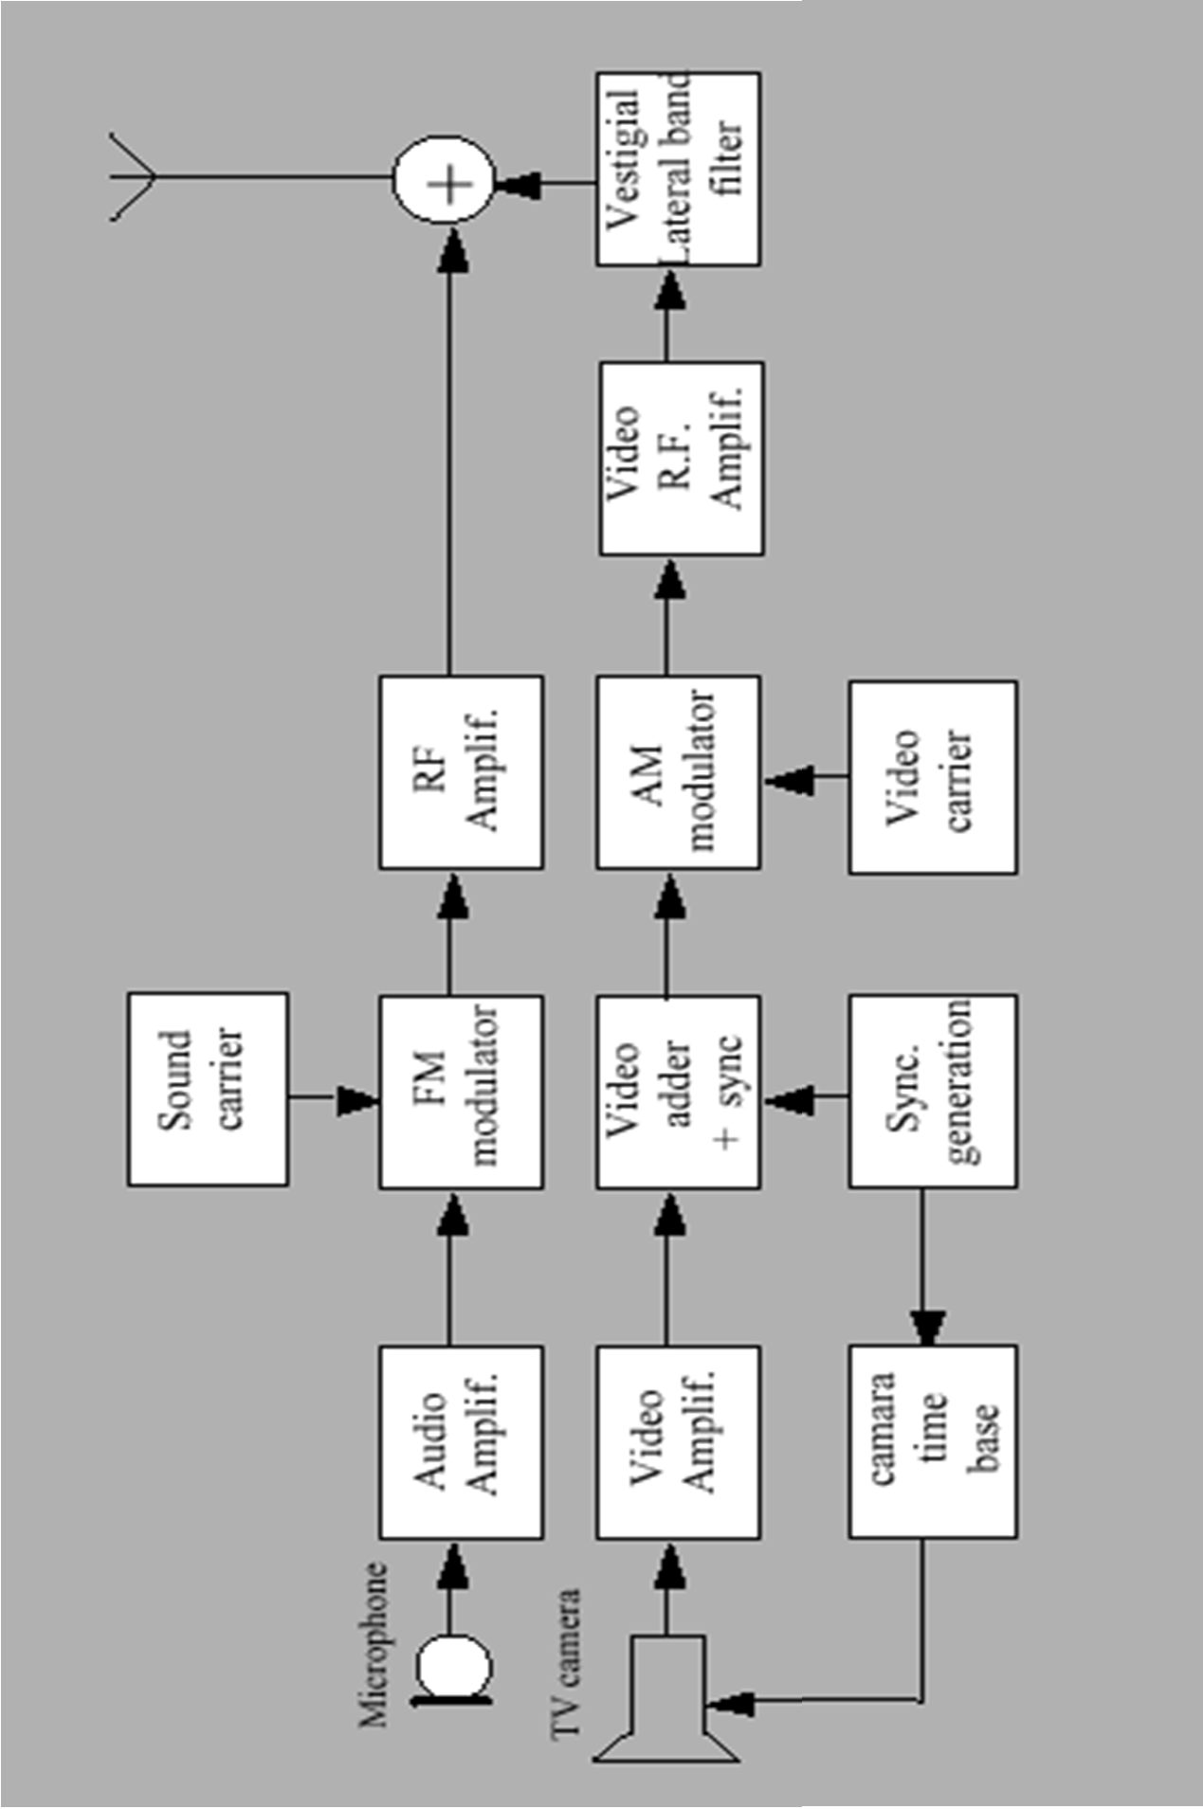
TV Transmitter (B&W)

Slide 11
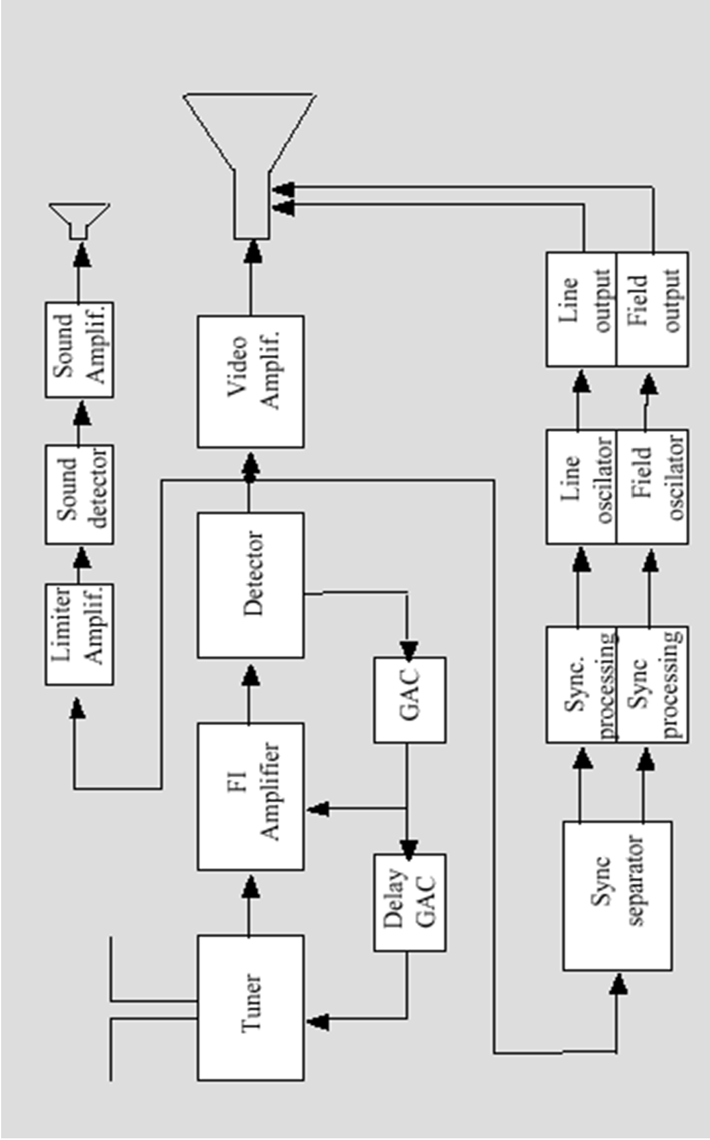
TV Receiver (B&W)

Slide 12
Beam Scanning :
The electron beam generated by the picture tube(standard vacuum tube theory)is accelerated toward the anode by a combination of elements and extreme high voltage(difference of potential) until it strikes the anode.
The high energy impact emits light or a dot in the center of the picture tube which is visible to our eyes.

Slide 13
Thank you

